Slide 1
Smart Networked Assistant for Purchase Processing (SNAPP)
GenAI Hackathon Team 5
Srinivas Lakshmi Bannuru
Nitin Chaudhary
Ardhendu Banerjee
Prashant Singh Chauhan
Pratik Bendre
Mentored By: Ravi Shankar

Slide 2
Table Of Content
Introduction
Motivation
Notable Works
Objective
Workflow
Experiment
Use Case
Limitation
Future Scope
Conclusion
Reference

Slide 3

GenAI Technologies
Generative AI creates content like text, images, and music using machine learning models.
Agents are AI programs that perform specific tasks autonomously, interacting with their environment to achieve goals. They can learn and adapt based on new data or experiences.
Multi-agent systems involve multiple AI agents working together or competing, often simulating complex behaviors.
Source Image: https://developer.nvidia.com/blog/introduction-to-llm-agents/
Notes:
Use case: demo for language

Slide 4




GenAI Frameworks
GenAI frameworks are software tools and libraries that simplify the development and deployment of generative AI models.
They provide pre-built components, model architectures, and training utilities, making it easier for developers to create and experiment with generative AI applications.
Some of the popular GenAI frameworks are:
Autogen
Langchain
CrewAI
AutoGPT
Notes:
rag

Slide 5
Motivation
A purchase order (PO) is a legal document that a buyer sends to a seller to authorize a purchase of goods or services
The approver is required to manually go through each purchase order to verify its details, a process that can become quite tiresome, especially when dealing with large volumes.
In some cases, the approver may encounter items or terms they are unfamiliar with, requiring additional time and effort to search the internet for clarification.
Additionally, there is the challenge of attachments being written in languages that the approver may not fully understand, complicating the verification process and potentially leading to errors or delays.

Slide 6
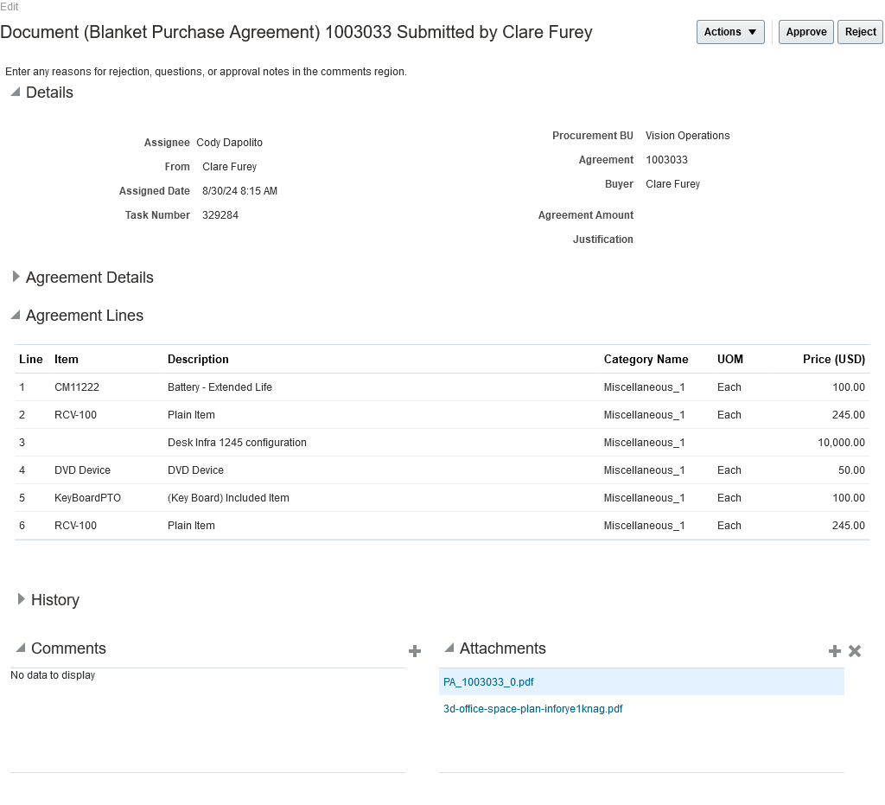

Slide 7
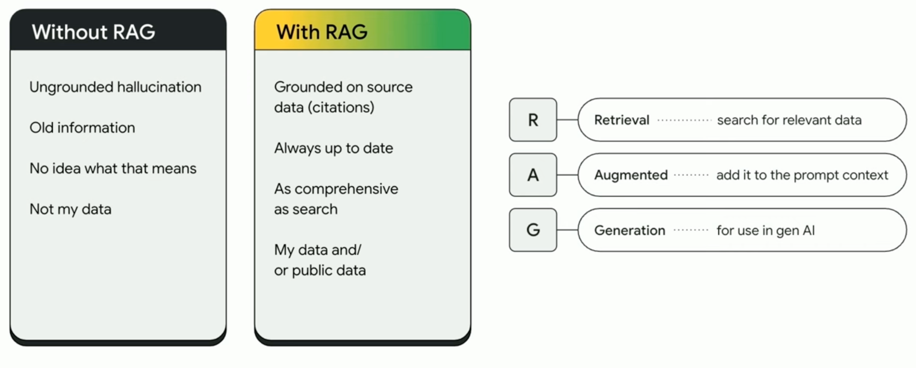
Retrieval-Augmented Generation (RAG)
RAG (Retrieval-Augmented Generation) is an AI framework that combines the strengths of traditional information retrieval systems (such as databases) with the capabilities of generative large language models (LLMs).
By combining this extra knowledge with its own language skills, the AI can write text that is more accurate, up-to-date, and relevant to your specific needs.
Source: Google
Notes:
Use case: demo for language

Slide 8
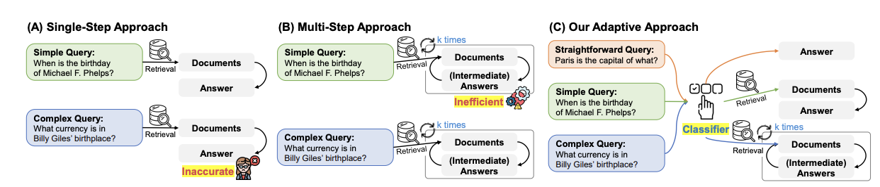
Adaptive-RAG [1]
Retrieval-Augmented Large Language Models enhance response accuracy by integrating external knowledge bases. While existing methods address various query complexities, they either inefficiently handle simple queries or struggle with complex, multi-step ones.
To address this, the authors propose an adaptive QA framework that dynamically selects the most suitable strategy based on query complexity.
This is achieved through a classifier—a smaller model trained to predict query complexity—enabling the system to balance between simple and complex retrieval methods, optimizing response accuracy across a range of queries.
[1]:Jeong, Soyeong, et al. "Adaptive-rag: Learning to adapt retrieval-augmented large language models through question complexity." arXiv preprint arXiv:2403.14403 (2024).

Slide 9
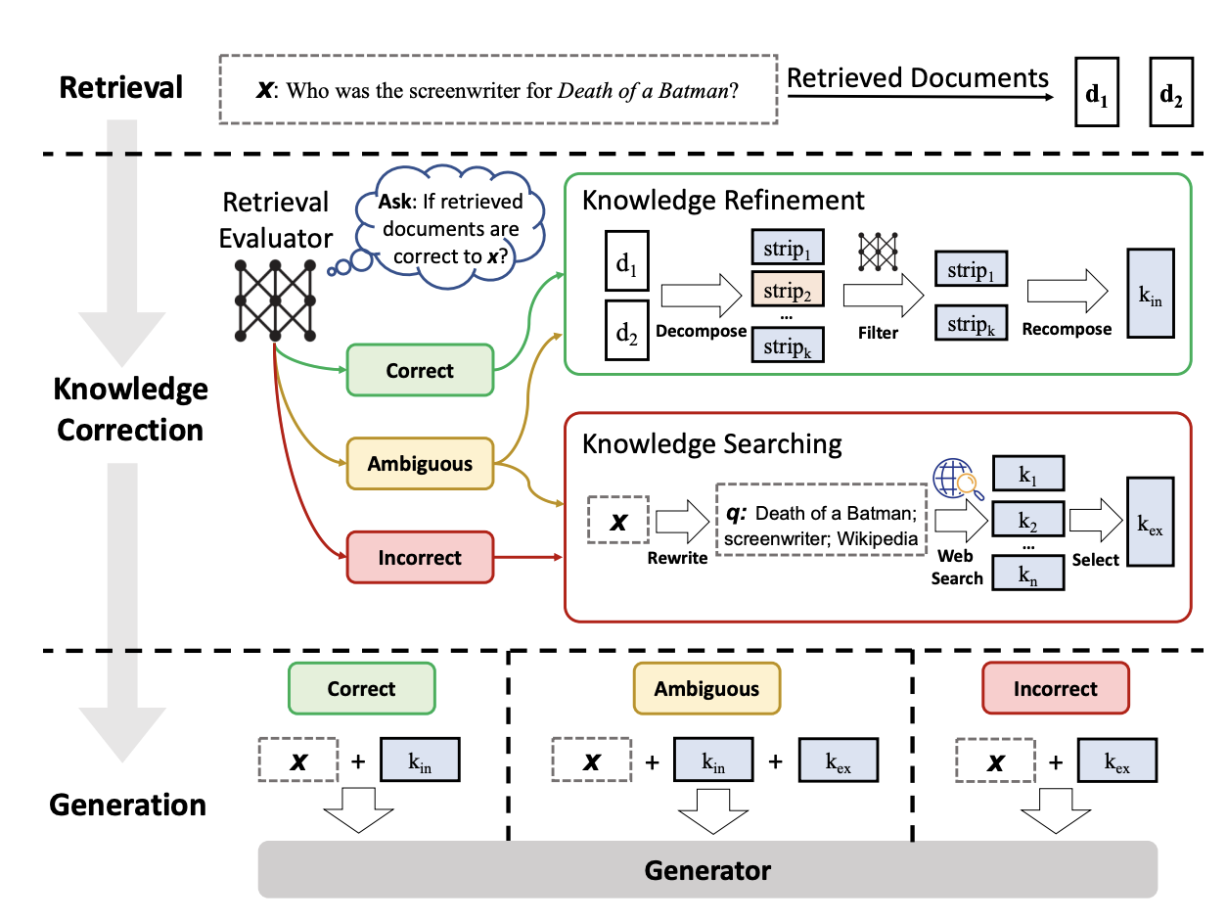
Corrective Retrieval Augmented Generation [2]
LLMs often produce hallucinations due to their reliance on internal knowledge alone. While RAG can help by incorporating external information, it depends on the relevance of the retrieved documents, which can lead to issues if retrieval fails.
To address this, the Corrective Retrieval Augmented Generation (CRAG) approach is introduced, featuring a retrieval evaluator that assesses the quality of retrieved documents and triggers different retrieval actions based on confidence levels.
[2]:Yan, Shi-Qi, et al. "Corrective retrieval augmented generation." arXiv preprint arXiv:2401.15884 (2024).

Slide 10
SELF-RAG [3]
A new framework called Self-Reflective Retrieval-Augmented Generation (SELF-RAG) is introduced by the authors that enhances an LM’s quality and factuality through retrieval and self-reflection.
The framework trains a single arbitrary LM that adaptively retrieves passages on-demand, and generates and reflects on retrieved passages and its own generations
[3]:Asai, Akari, et al. "Self-rag: Learning to retrieve, generate, and critique through self-reflection." arXiv preprint arXiv:2310.11511 (2023).

Slide 11
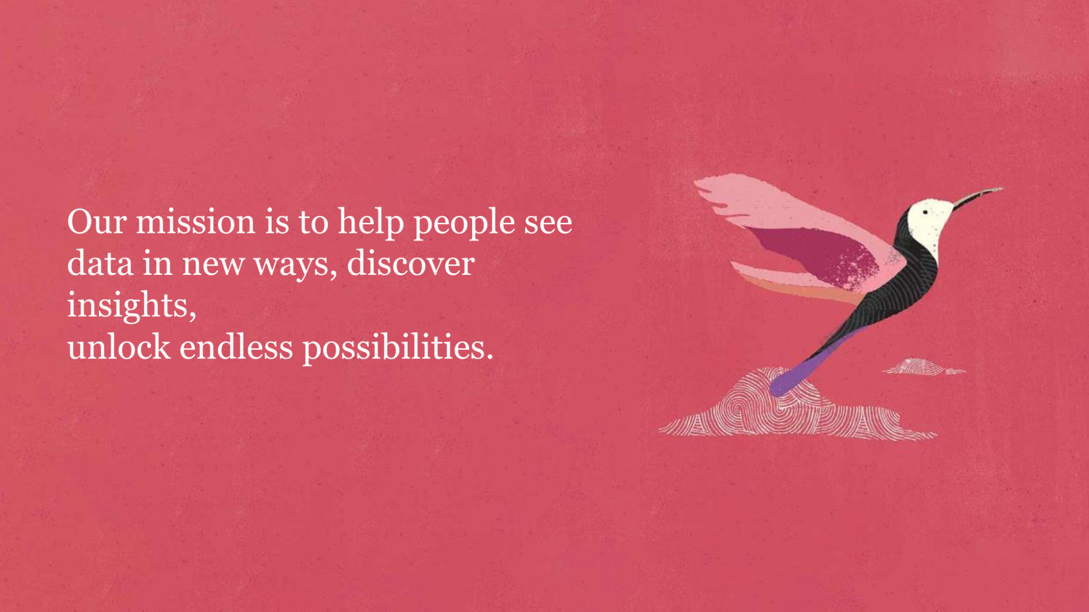
Objective:
The goal is to leverage generative AI and various RAG architectures to analyse the purchase order and provide the approver with a chatbot which answer all the queries related directly or indirectly to the purchase order regardless of the language

Slide 12
Elements of the Architecture
Agents Used:
Tool Used:
Translator: This agent translates given text into English text
Route Prompt : This agent determines if the question is related to the purchase order or not.
Grading Agent: Determines if fetched documents are relevant to the question. It also triggers web search if some external information is required.
Generate Agent : Generates and outputs the reply answer for the user prompt.
Hallucination Agent : Checks if the answer generated is supported by the documents.
Answer Grading Agent : Determines if the generated answer does indeed answer the question
Web Search Tool : This tool is used to search the internet for the requested data.
(Tavily Search API is a search engine optimized for LLMs and RAG, aimed at efficient, quick, and persistent search results)

Slide 13
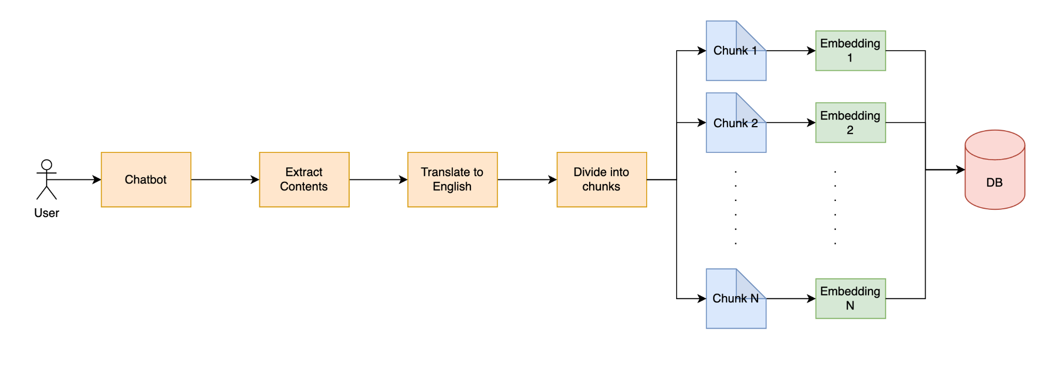
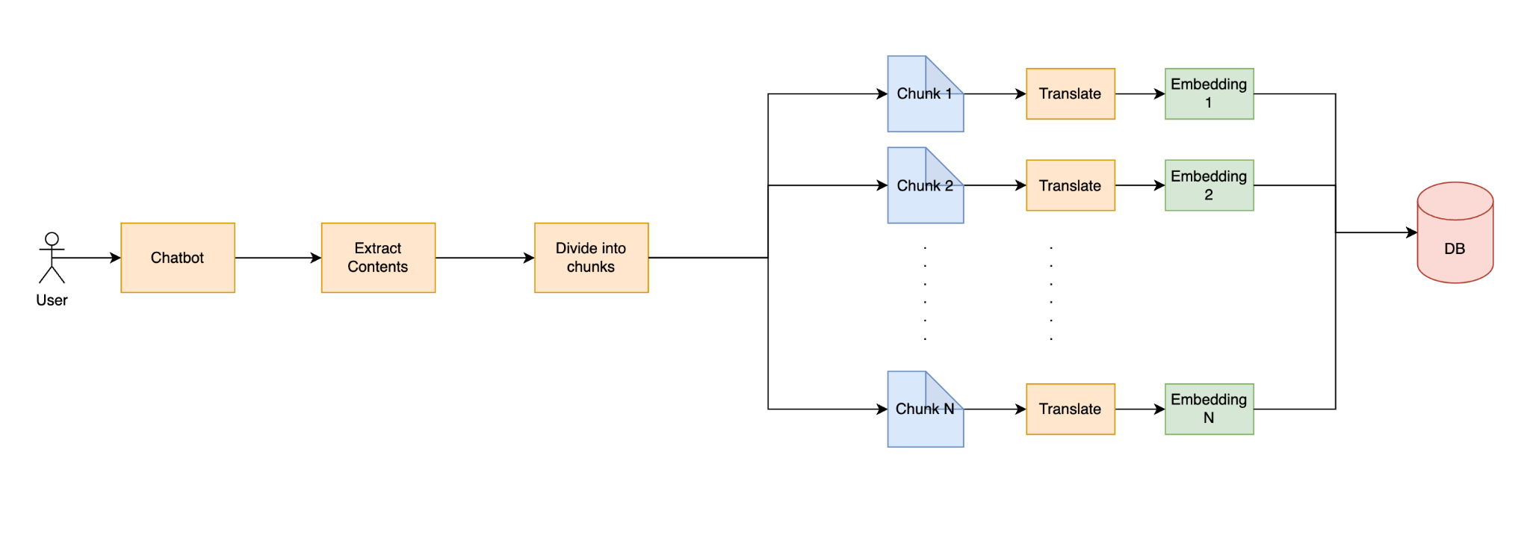
Pre-processing
On receiving the purchase order pdf provided by the user, following steps are taken to process the pdf
All text based contents are extracted from the PDF
The textual content is further divided into individual chunks
These chunks are stored as embeddings in the vector database

Slide 14
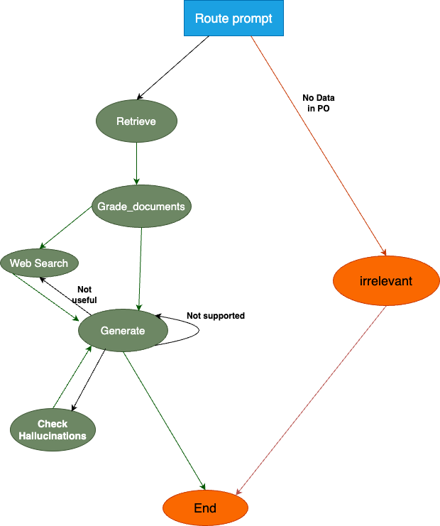
Overall Workflow

Slide 15
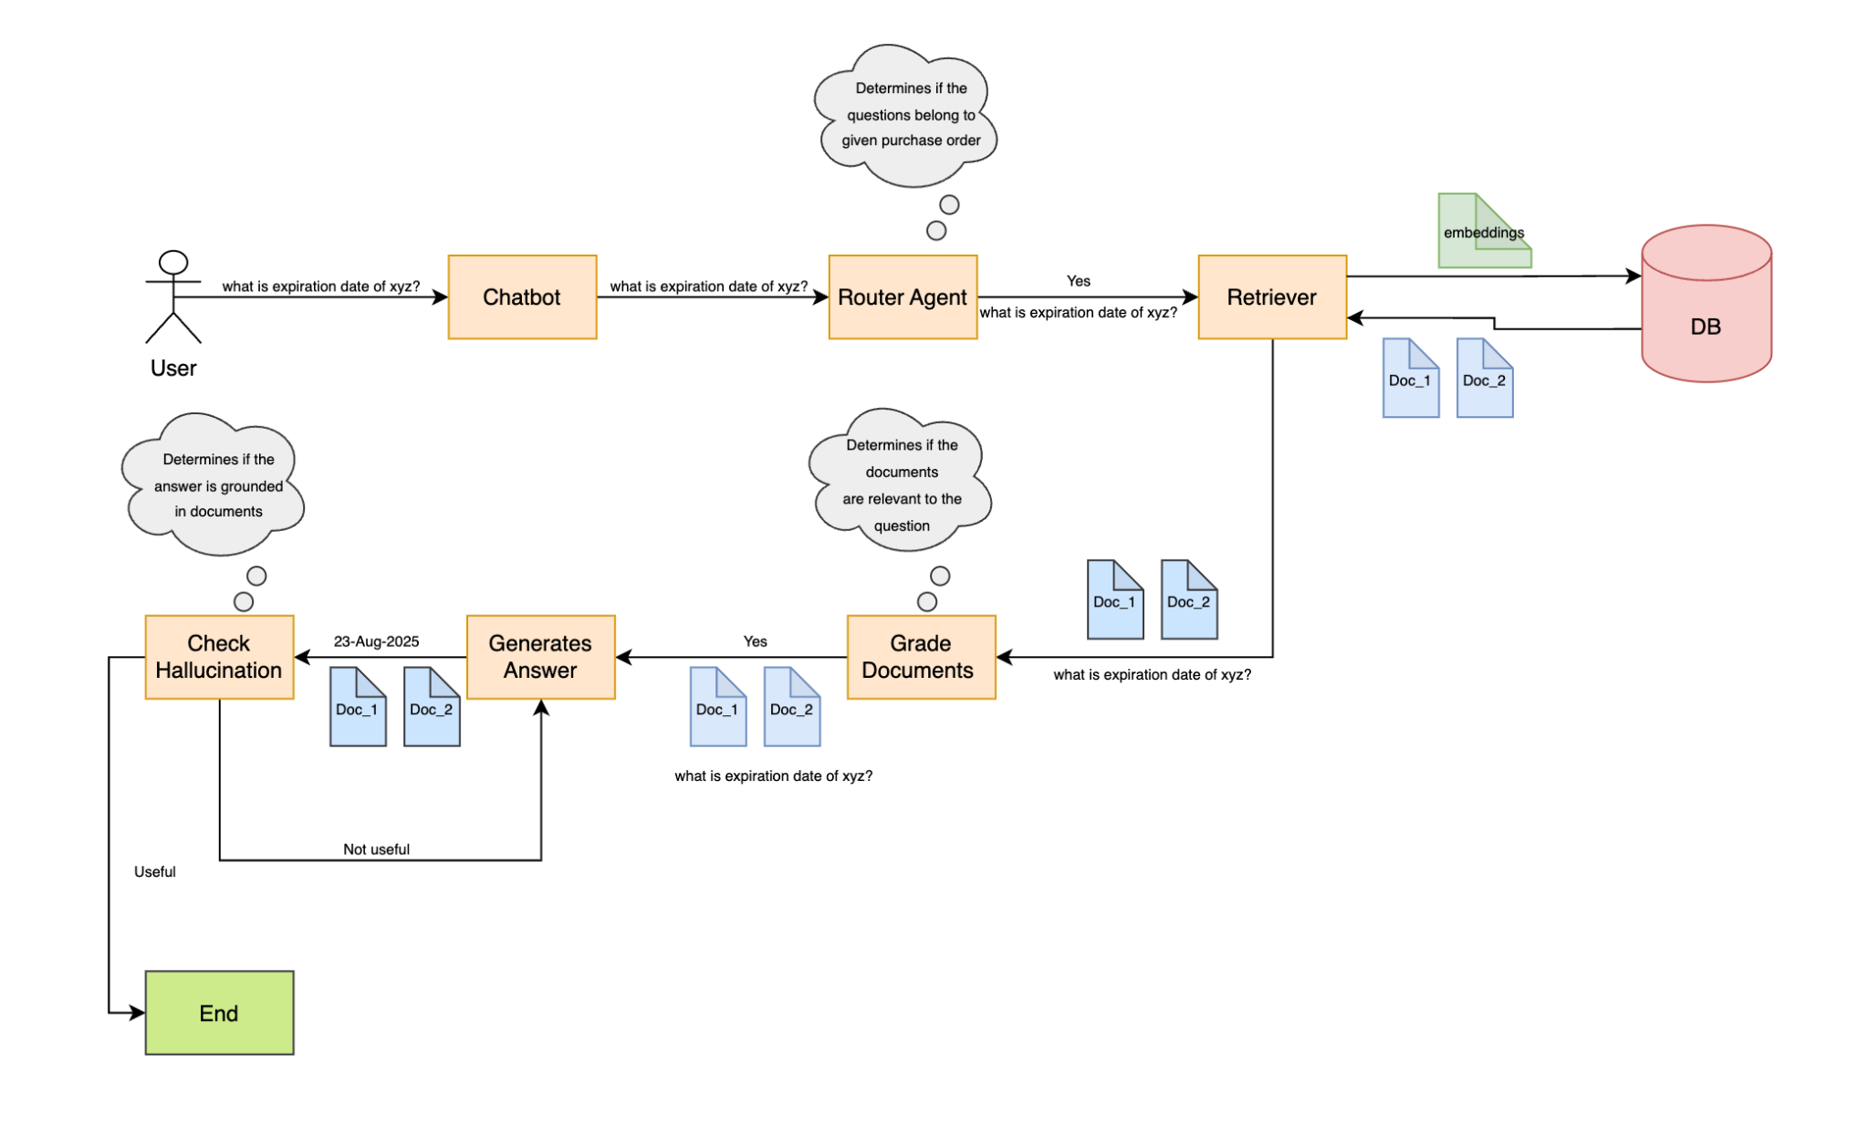
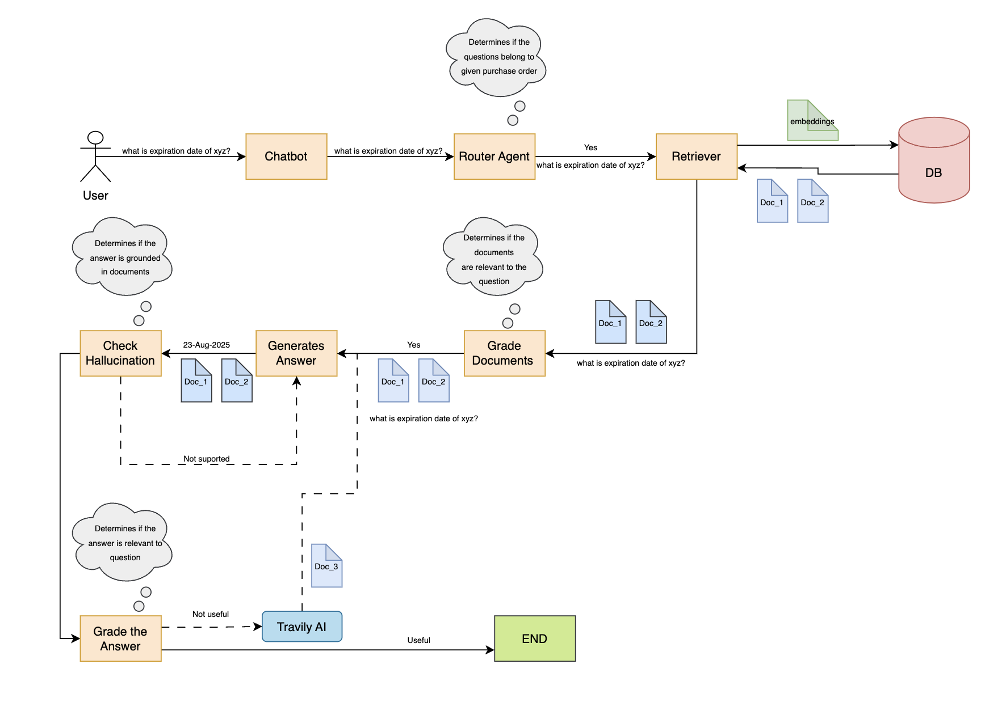
Workflow #1
This workflows describes the scenario when the question is within the context of provided document
Documents are fetched from DB and are used to answer the question

Slide 16
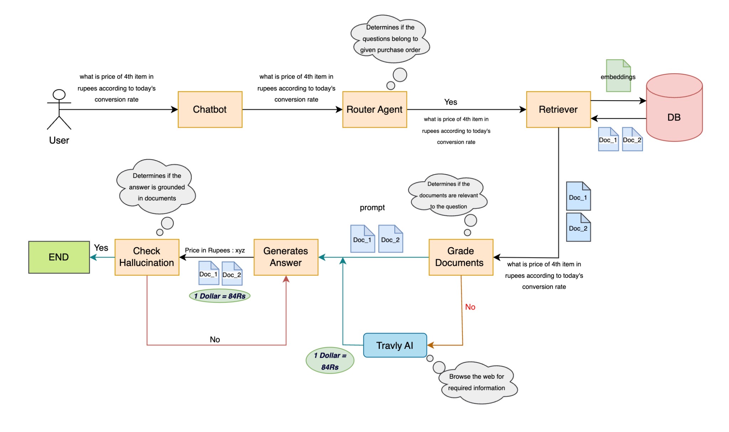
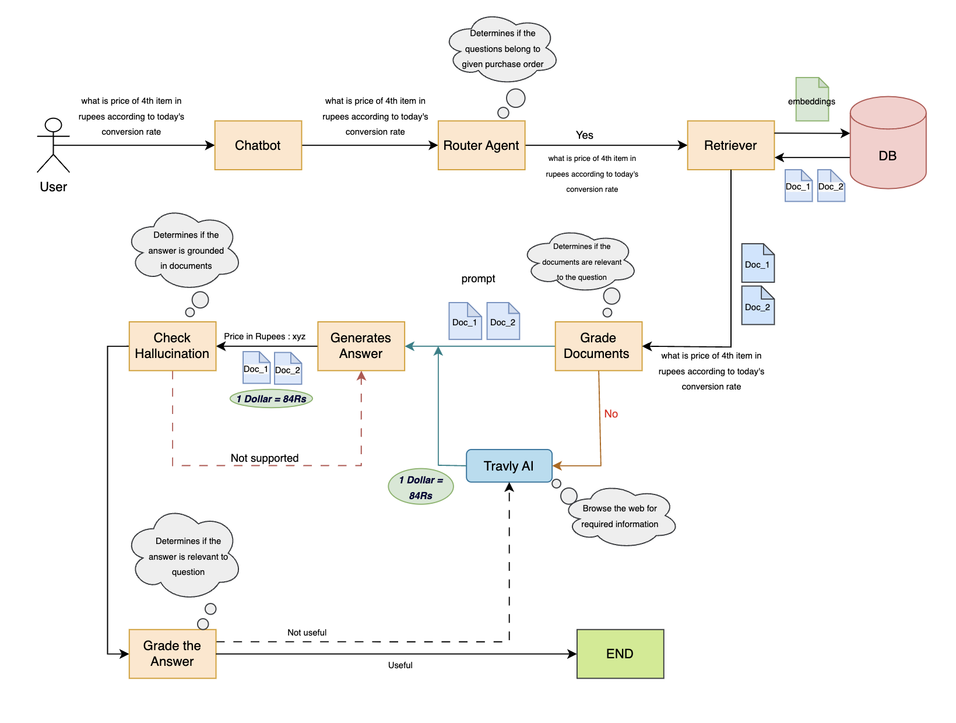
Workflow #2
This workflows describes the scenario when the question is partially within the context of provided document
Documents are fetched from DB and web are used to answer the question

Slide 17
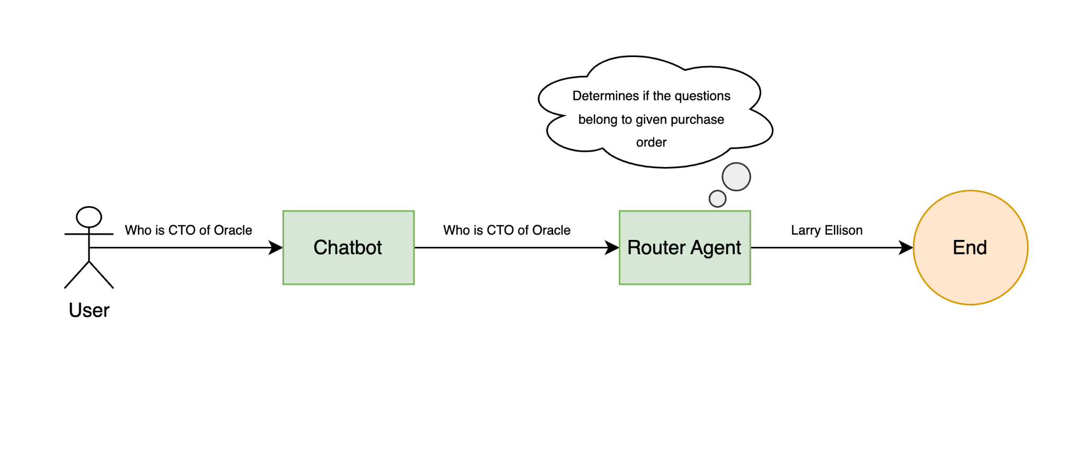
Workflow #3
This workflows describes the scenario when the question is not at all within the context of provided document
Documents are fetched from web are used to answer the question

Slide 18
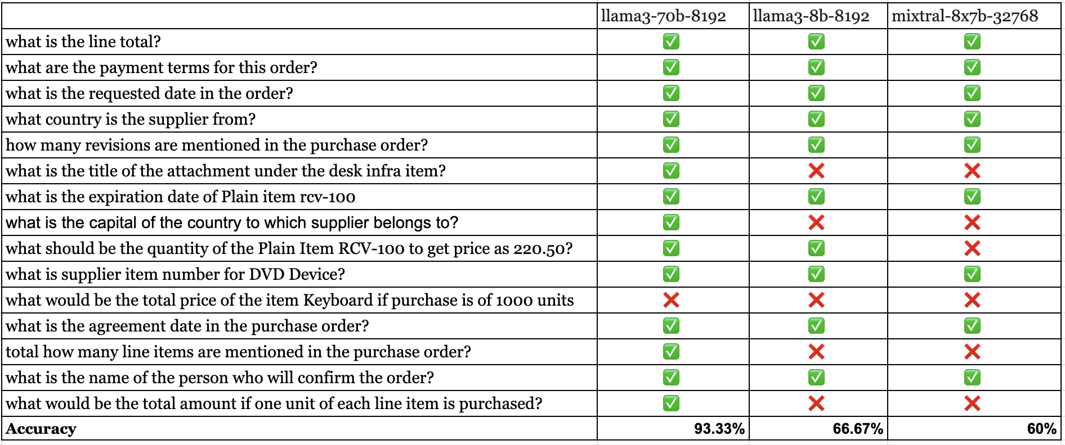
Experiments

Slide 19
Live Demo
[3]:Asai, Akari, et al. "Self-rag: Learning to retrieve, generate, and critique through self-reflection." arXiv preprint arXiv:2310.11511 (2023).

Slide 20
Use Cases

Slide 21
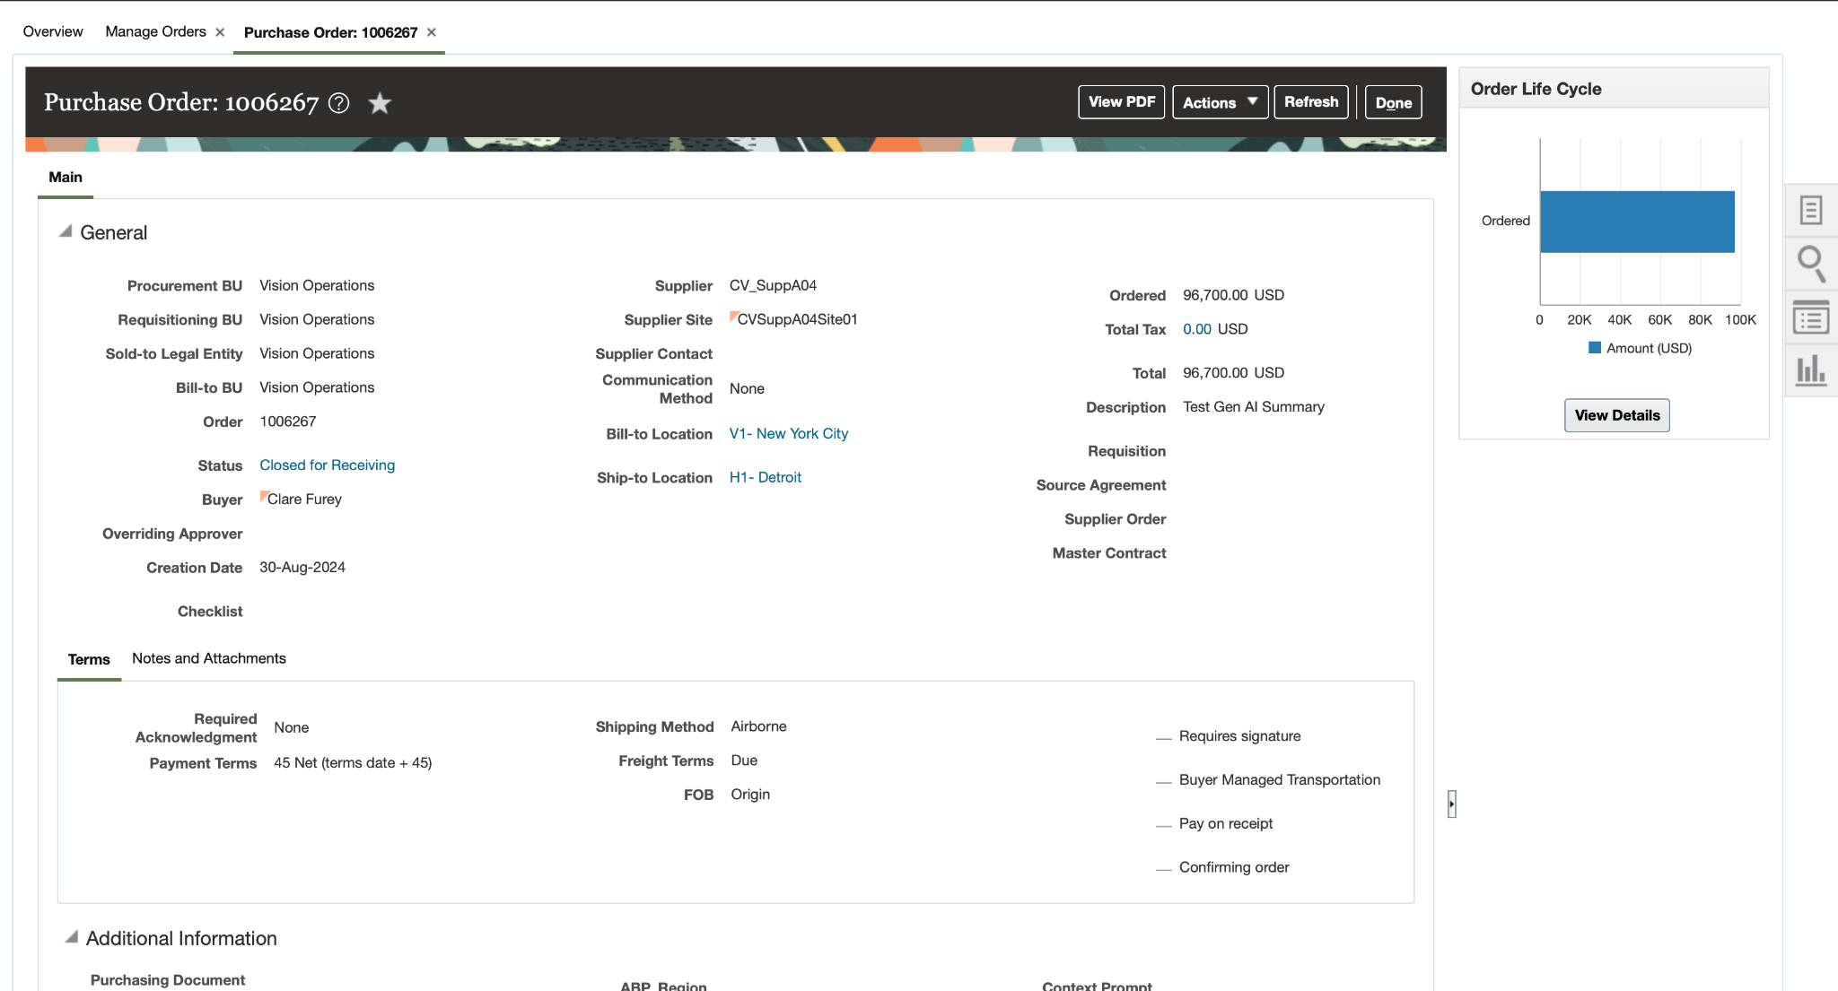

Slide 22


Slide 23
Limitation
Given that the free version of the Groq API is being used to access the Llama model, response times may be slower than expected.
Furthermore, due to the constraints of the free version, there are limitations on the number of tokens that can be processed. As a result, larger documents may not be successfully processed or may fail to yield any output.

Slide 24

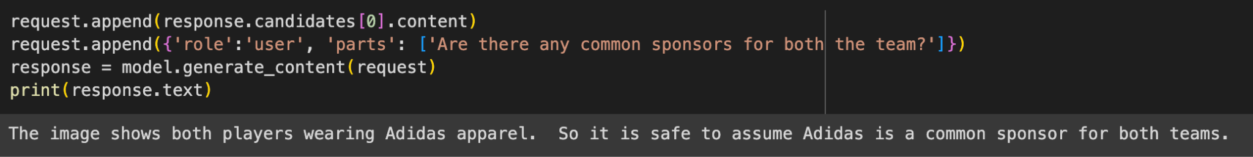
Future Scope
Use of premium LLMs to further refine the output.
Support for documents that contain mixed type of content (images and tables)

Slide 25
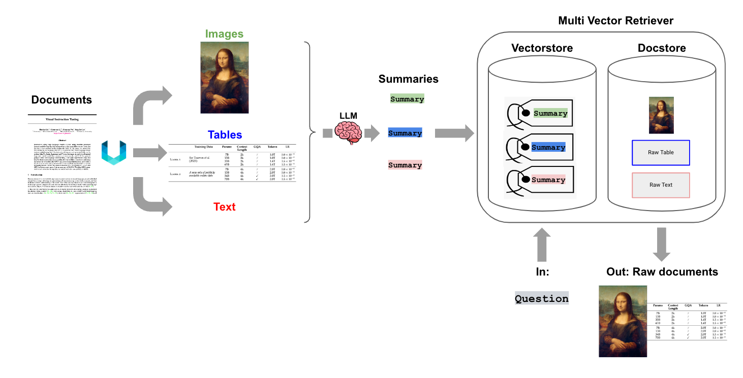
Multi-Vector Retriever
It creates a summary of a verbose document optimized to vector-based similarity search, but still pass the full document into the LLM to ensure no context is lost during answer synthesis.
https://blog.langchain.dev/semi-structured-multi-modal-rag/

Slide 26
Conclusion
SNAPP is a multi agent chatbot which can resolve queries of the approver by reviewing the provided purchase order.
It uses multiple agents to verify the generated answer to make sure the results are as accurate as possible

Slide 27
References
Jeong, Soyeong, et al. "Adaptive-rag: Learning to adapt retrieval-augmented large language models through question complexity." arXiv preprint arXiv:2403.14403 (2024).
Yan, Shi-Qi, et al. "Corrective retrieval augmented generation." arXiv preprint arXiv:2401.15884 (2024).
Asai, Akari, et al. "Self-rag: Learning to retrieve, generate, and critique through self-reflection." arXiv preprint arXiv:2310.11511 (2023).
https://medium.com/the-ai-forum/build-a-reliable-rag-agent-using-langgraph-2694d55995cd

Slide 28
Questions for us?

Slide 29
Thank You!

